Slide 1
A Neural Network Approach to Predict Stock Performance Presented by: Jiarui Zhang Che Wang

Slide 2
Presentation Outline
Introduction
Problem Description
Motivation
Neural Network
Data set
Empirical study
Test Results
Conclusion

Slide 3
Introduction
Trading is the process of buying and selling of financial instruments
Stock market
market for the trading
one of the most important sources for companies to raise money
allows businesses to go public, or raise additional capital for expansion

Slide 4
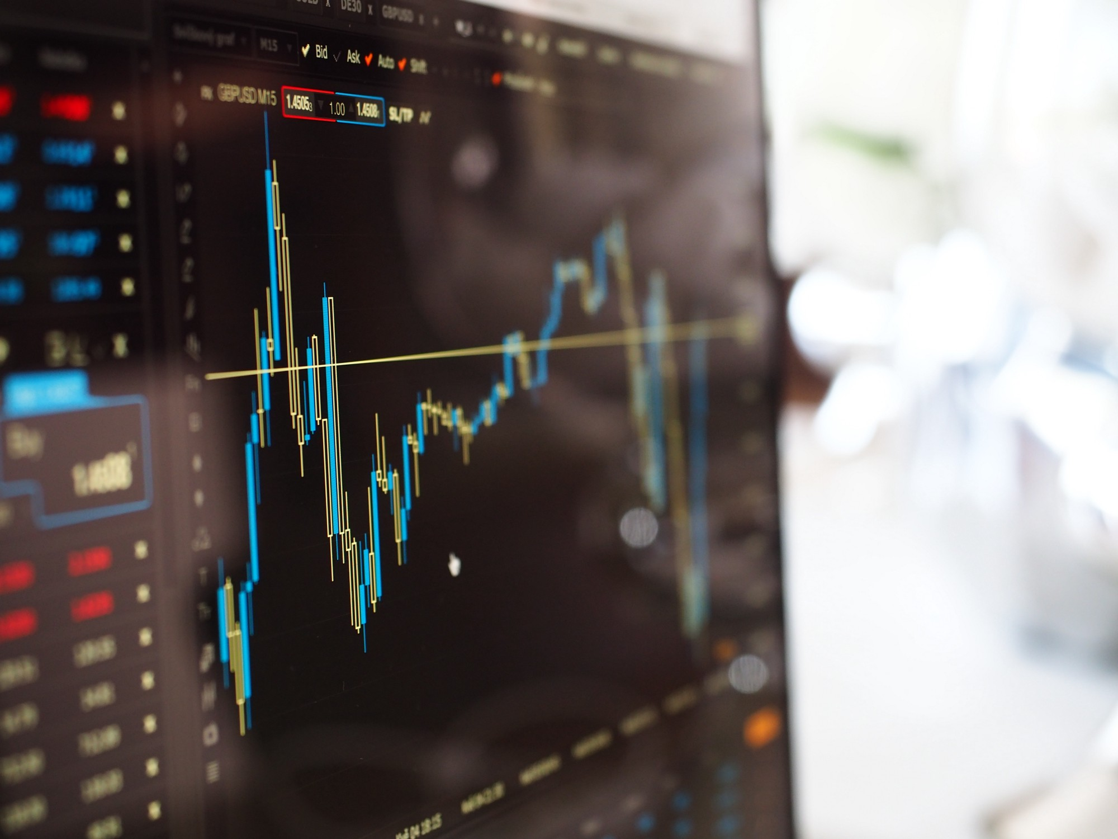
Problem Description
Collect a sufficient amount of historical stock data
Using the data train a neural network
Once trained, the neural network can be used to predict stock behaviour

Slide 5
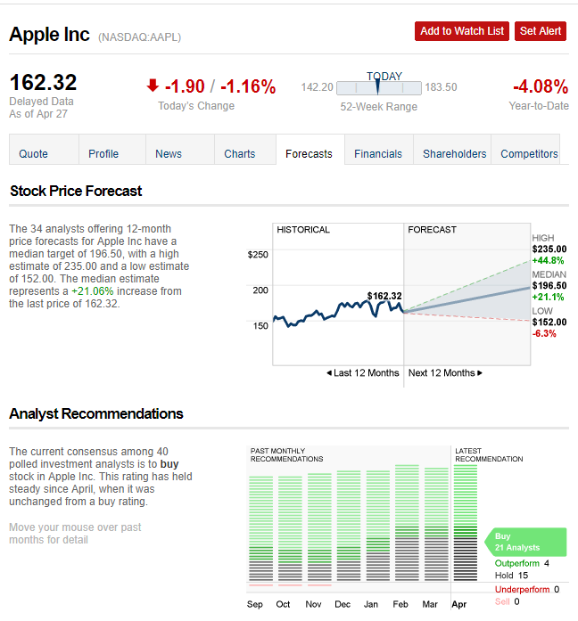
Motivation
Stock Prediction is more or less like Pattern Recognition
NN is a power tool for Pattern Recognition
Notes:
Picture is from CNN Money .
Predicting stock performance is a very large and profitable area of study
Many companies have developed stock predictors based on neural networks
This technique has proven successful in aiding the decisions of investors
Can give an edge to beginning investors who don’t have a lifetime of experience

Slide 6
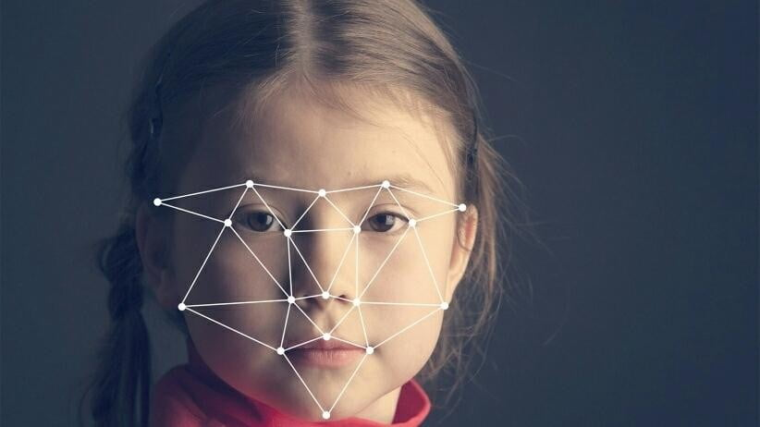
Artificial Neural Network

Slide 7
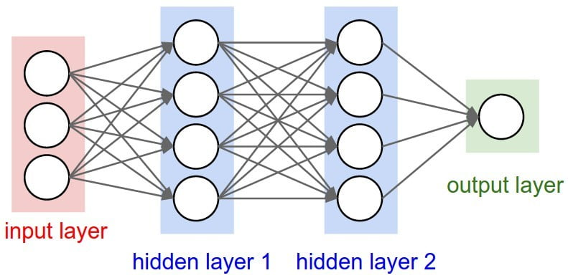
What is Neural Network?
1
Consists of one input , one output and multiple fully-connected hidden layers in between.
Notes:
Each layer is represented as a series of neurons and progressively extracts higher and higher-level features of the input until the final layer essentially makes a decision about what the input shows. The more layers the network has, the higher-level features it will learn.

Slide 8
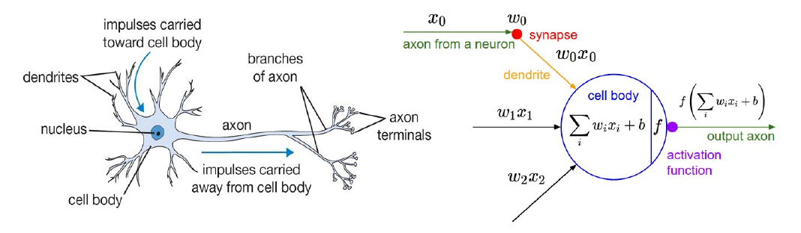
What is Neural Network?
Notes:
Similar to logistic regression function . Neurons are trained to filter and detect specific features or patterns (e.g.edge) by receiving weighted input, transforming it with the activation function and passing it to the outgoing connections.

Slide 9
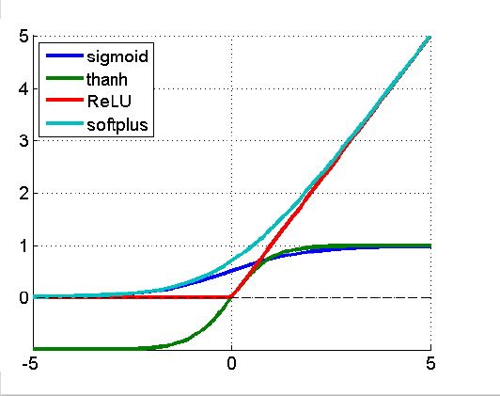
Activation Function
Activation functions are important elements of the network architecture since they introduce non-linear, otherwise the NN would be just a linear function.
Notes:
Most deep networks use ReLu-max(0,X) – nowadays for hidden layers, since it trains much faster, is more expressive than logistic function and prevents the gradients vanishing problem.

Slide 10
Activation Function
Most deep networks use ReLu-max(0,X) – nowadays for hidden layers, since it trains much faster, is more expressive than logistic function and prevents the gradients vanishing problem.

Slide 11
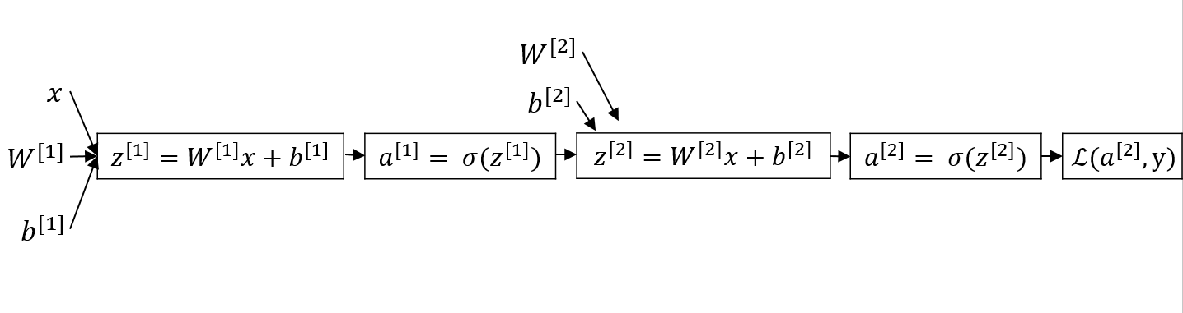
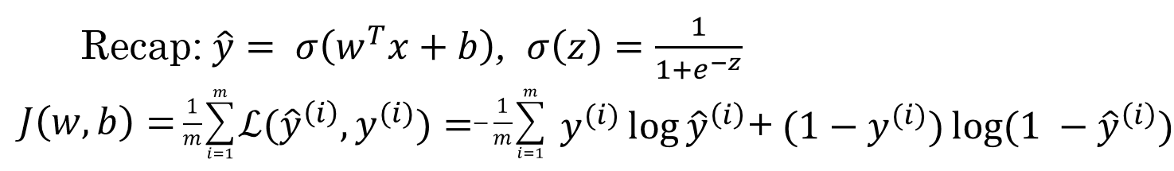
Cost Function
Notes:
The value of cost function is sum up all of the lost function.

Slide 12
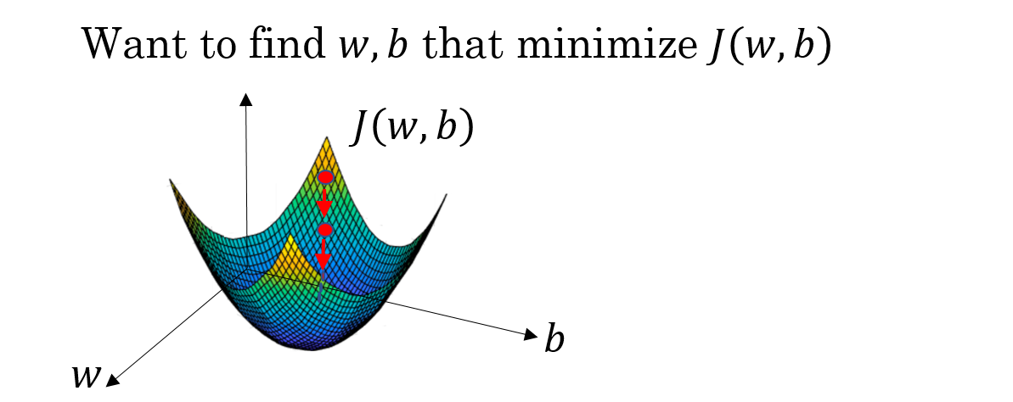
Gradient Descent

Slide 13

Benefits with NN
Generalization ability and robustness
Mapping of input/output
No assumptions of model has to be made
Flexibility

Slide 14
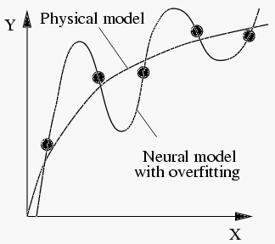
Drawbacks with NN
Black-box property
Overfitting
Expertise for choice of input
Training takes a lot of time

Slide 15

Stock Market Price Prediction

Slide 16
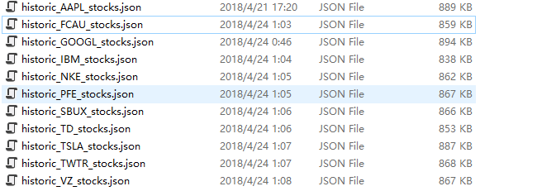
Stock Market Price Data Set
Stock of these companies : APPLE, FCAU, GOOGLE, IBM, NIKE, PFE,SBUX,TD,TSLA,TWTR,VZ
And the data was grabbed by google finance API

Slide 17
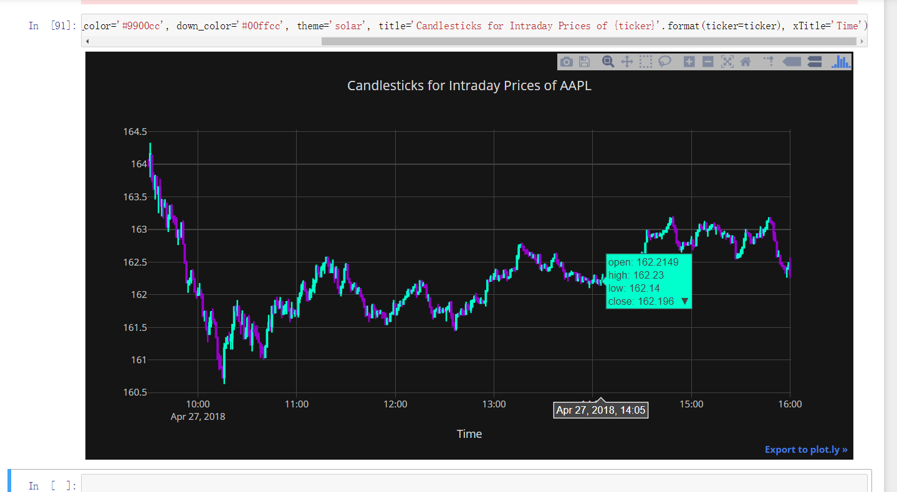
Grabbing Stock Market Price Data

Slide 18
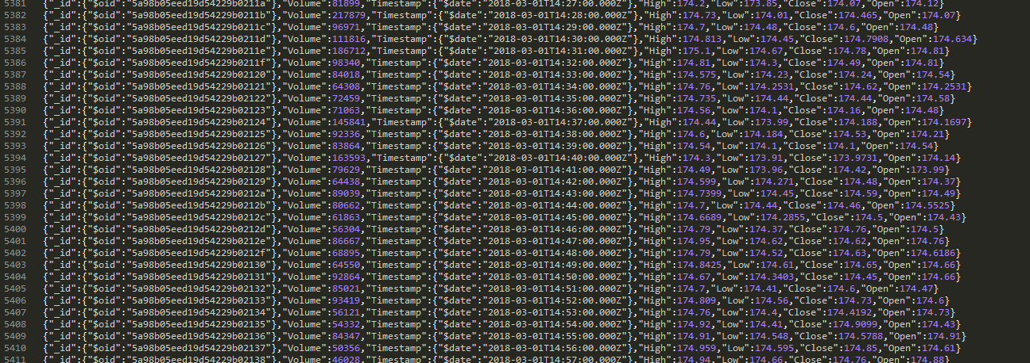
Stock Market Price Data Set

Slide 19
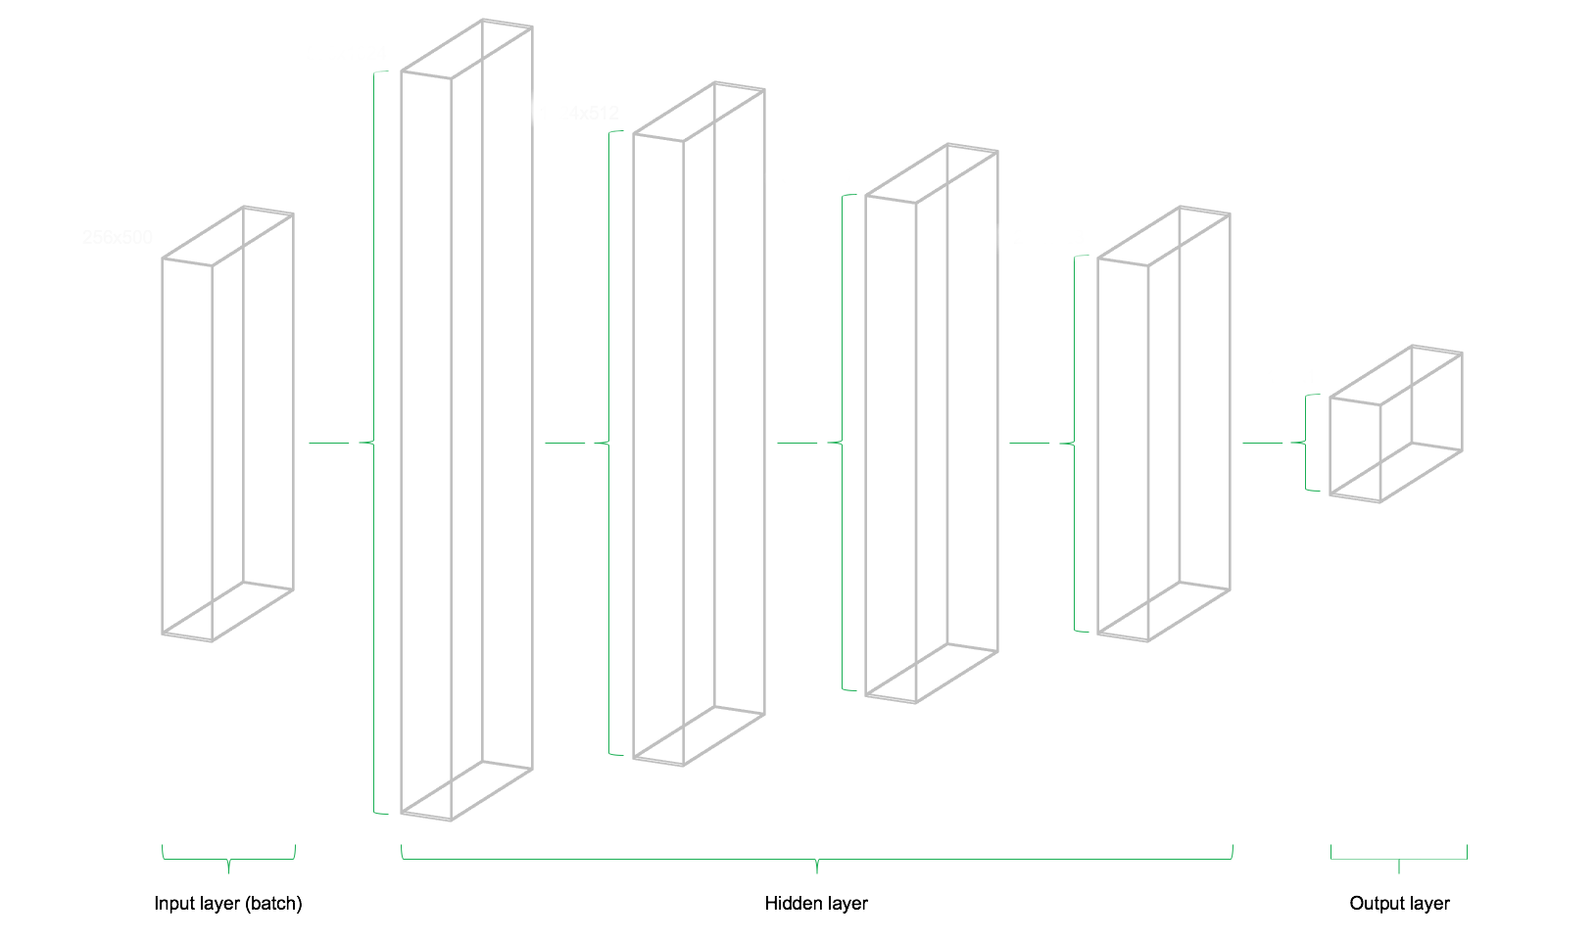
Network Architecture
The left image illustrates the network architecture. The model consists of three major building blocks. The input layer, the hidden layers and the output layer. This architecture is called a feedforward network. Feedforward indicates that the batch of data solely flows from left to right. Other network architectures, such as recurrent neural networks, also allow data flowing “backwards” in the network.

Slide 20
Adam Optimizer:
The Adam Optimizer has the combination of the advantages of two other extensions of stochastic gradient descent. Specifically:
Adaptive Gradient Algorithm (AdaGrad) that maintains a per-parameter learning rate that improves performance on problems with sparse gradients (e.g. natural language and computer vision problems).
Root Mean Square Propagation (RMSProp) that also maintains per-parameter learning rates that are adapted based on the average of recent magnitudes of the gradients for the weight (e.g. how quickly it is changing). This means the algorithm does well on online and non-stationary problems (e.g. noisy).

Slide 21
Pattern Recognition
Structure: 1 input layer/batch 4 hidden layers with 1024, 512, 256, 128 neurons respectively 1 output layer
Purpose: Use neural network to study the relation of stock 0 using stock prices of stock 1-9 and thus predict the future pattern of stock 0.
1 batch
S
T
O
C
K
0
S
T
O
C
K
1
S
T
O
C
K
2
S
T
O
C
K
3
S
T
O
C
K
4
S
T
O
C
K
5
S
T
O
C
K
6
S
T
O
C
K
7
S
T
O
C
K
8
S
T
O
C
K
9
Training Data:
0.8
of
whole
data
Tool: Neural Network from TensorFlow
Result:
Testing
Data:
0.2
of
whole
data
y
X

Slide 22

THANKS!

